Slide 1
Data-Driven Insights for Optimizing Retail Sales Performance
Dataset: Retail Store
By: S.KRISHNA KUMAR
Batch – July 2025 – Cohort(“A”)
Subject - DADS

Slide 2
Contents of this template
INTRODUCTION
DATA UNDERSTANDING
DATA CLEANING
HANDLING MISSING VALUES
OUTLIER HANDLING
HANDLING INVALID VALUES
STATISTICAL ANALYSIS
DESCRIPTIVE ANALYSIS
RELATIONSHIP BETWEEN VARIABLES
UNIVARIATE ANALYSIS
BI-VARIATE ANALYSIS
MULTI-VARIATE ANALYSIS
CONCLUSION AND RECOMMENDATION

Slide 3
INTRODUCTION
Objective: This project focuses on analyzing retail sales data to understand the meaningful insights about customer behavior, product performance, and payment trends. By data cleaning, transformation, and visualization techniques, the project transforms raw, unstructured data into actionable information. Problem Statement: Understand key spending patterns across customers. Identify top-selling products and preferred payment methods. Generate insights that help optimize inventory planning, improve marketing strategies

Slide 4
Data Understanding
Dataset: Retail store sales dataset containing transactions with customer, product, and payment details. Key Attributes: Transaction ID, Customer ID, Category, Item, Price per Unit, Quantity, Total Spent, Payment Method, Location, Transaction Date, and Discount Applied. Dataset: Retail store transactions (12,575 rows, 11 columns).

Slide 5
Data Cleaning
Why Cleaning is Necessary: To remove errors, inconsistencies, and missing values so the analysis is accurate, reliable, and meaningful.
Key Steps Taken:
Handled missing and duplicate records.
Corrected data types (dates, numbers, categories).
Removed outliers in Total Spent and Quantity.
Standardized category names and payment methods.
Created new derived columns (Month, Day, Quarter) for better analysis.

Slide 6
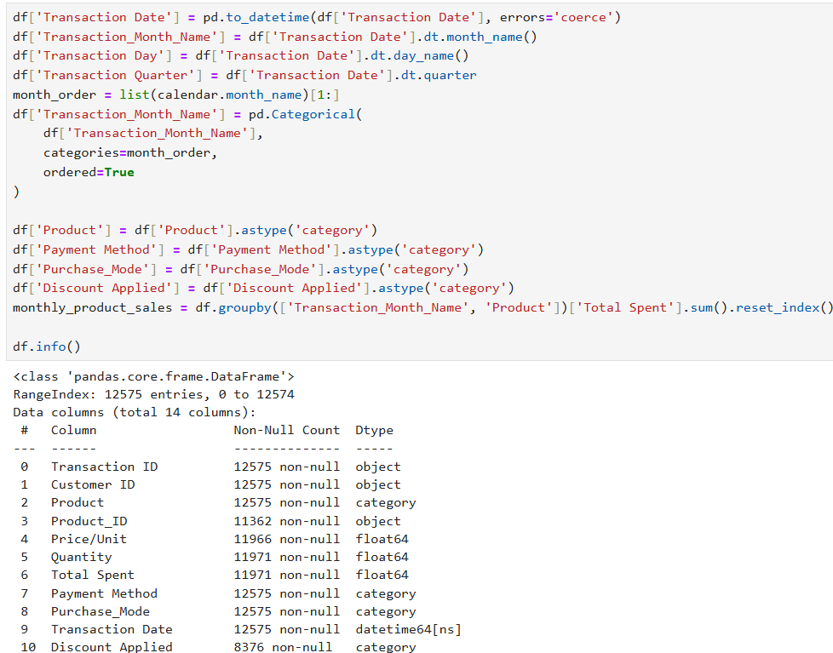
Data Cleaning (Sample Image)

Slide 7
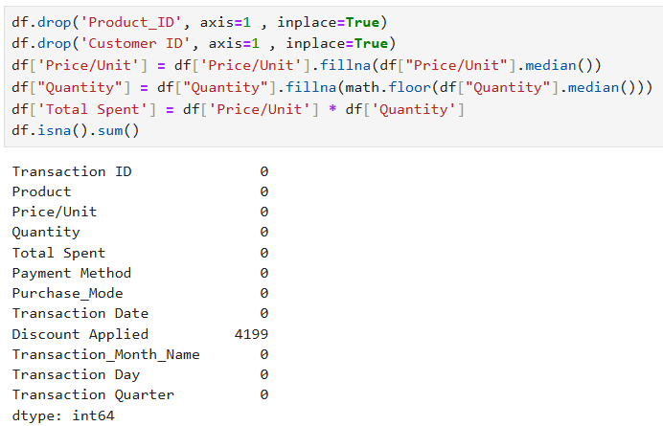
Data Cleaning (Sample Image)

Slide 8
Handling Missing Values
Approach:
Ensured that missing data does not distort analysis by carefully filling or removing gaps.
Methods Used:
Deletion: Removed rows with completely empty or irrelevant records.
Imputation: Filled missing numerical values with mean/median where appropriate.
Standardization: Replaced missing categorical values with most frequent category (mode).

Slide 9
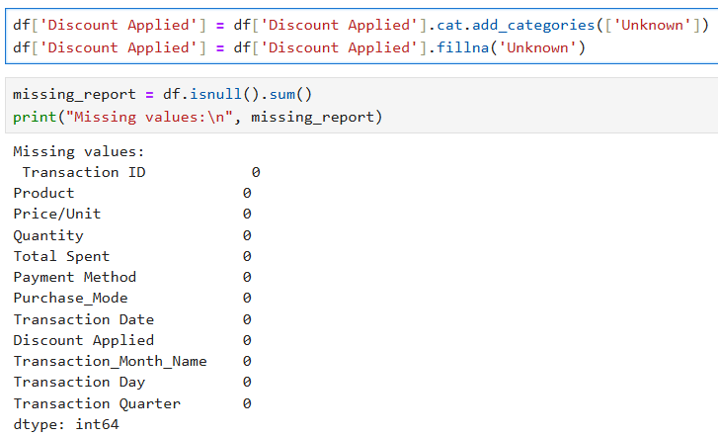
Handling Missing Values

Slide 10
Handling Outlier Handling
Identification:
Used Boxplots and IQR methods to detect unusually high or low values in Total Spent and Quantity.
Visualized data distributions to confirm extreme points.
Techniques Used:
Removal: Dropped extreme outliers that could skew results.
Capping: Applied upper&lower limits for certain attributes to retain valid data while reducing impact of extremes.

Slide 11
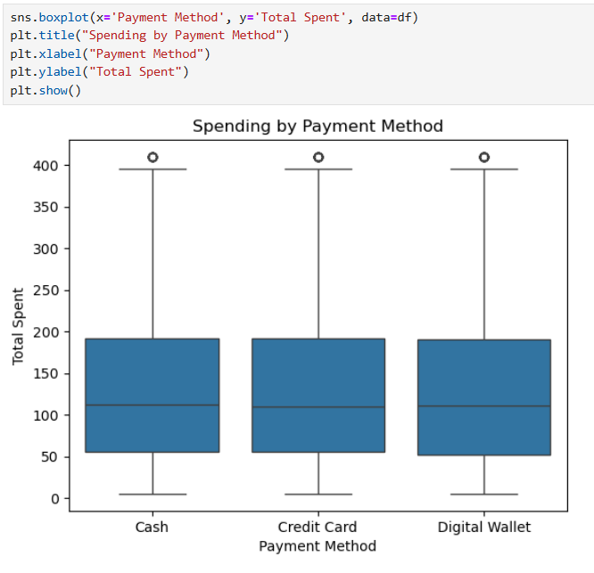
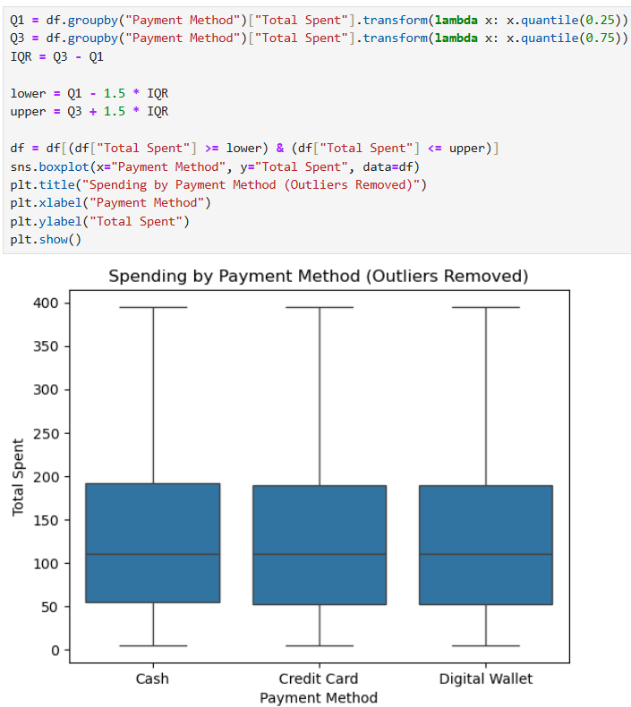
Before and After Handling Outlier

Slide 12
Handling Invalid Values
Main Idea is to handle invalid values are some data points can distort analysis and lead to misleading insights.
Steps Taken:
Detected & Removed Impossible Entries
Converted “Transaction Date” to valid Datetime Format
Checked and replaced unexpected values in “Payment Method” , “Purchase_Mode”
Cross-Verified and replaced incorrect values in “Total Spend = (Price*Quantity)”

Slide 13
Statistical analysis
Overview:
Statistical analysis was used to summarize data trends, validate assumptions, and uncover significant patterns.
Key Methods Applied:
Hypothesis Testing:
ANOVA Test: Checked if mean spending differed across Payment Methods → Result: No significant difference (p > 0.05).
Two-Sample T-Test: Compared Online vs In-Store Purchase Modes → Result: No significant difference in average spending (p > 0.05).
Correlation Analysis:
Examined relationships between Quantity, Price/Unit, & Total Spent.

Slide 14
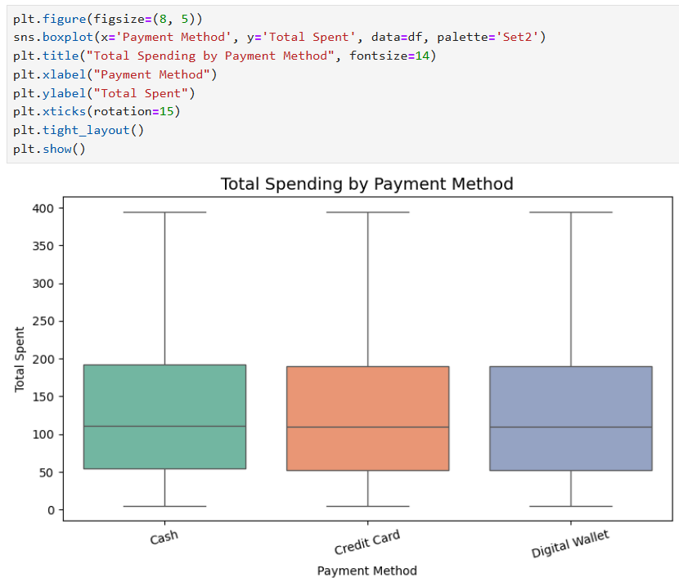
Statistical Analysis
ANOVA & Pairwise T-Tests
(Payment Method vs Total Spent)

Slide 15
Descriptive analysis
Overview: Descriptive statistics were used to summarize and understand the dataset’s key characteristics before deeper analysis.
Key Measures Calculated:
Central Tendency: Mean, Median, Mode for (Total Spent, Quantity, Price/Unit)
Dispersion: Standard Deviation, Variance, Range to measure spread of data
Shape of Distribution: Skewness and Kurtosis to detect asymmetry and peakness
Outliers: Identified using IQR method and boxplots

Slide 16
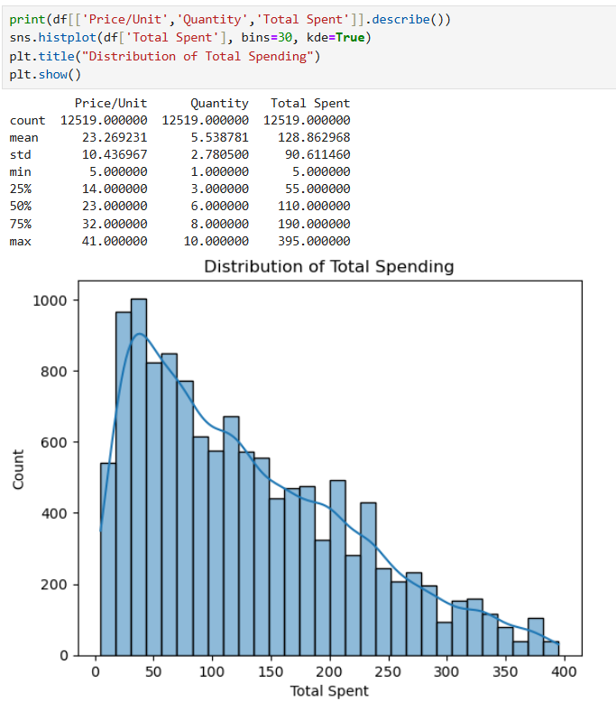
Descriptive Analysis

Slide 17
Relationship between variables
Variables Analyzed:
Numerical vs. Numerical: Total Spent, Quantity, Price/Unit
Categorical vs. Numerical: Payment Method, Purchase Mode vs. Total Spent
Categorical vs. Categorical: Purchase Mode × Payment Method
Statistical Tests Used:
Correlation Analysis: Pearson correlation between numerical variables (Total Spent, Quantity, Price/Unit)
One-Way ANOVA: Tested if Total Spent differs significantly across Payment Methods
Two-Sample T-Test: Compared mean Total Spent between Online and In-store purchases

Slide 18
Relationship between variables
Key Findings:
Moderate positive correlation between Quantity and Total Spent → higher quantities lead to higher spend.
ANOVA Results: No statistically significant difference in mean spend across payment methods (p > 0.05).

Slide 19
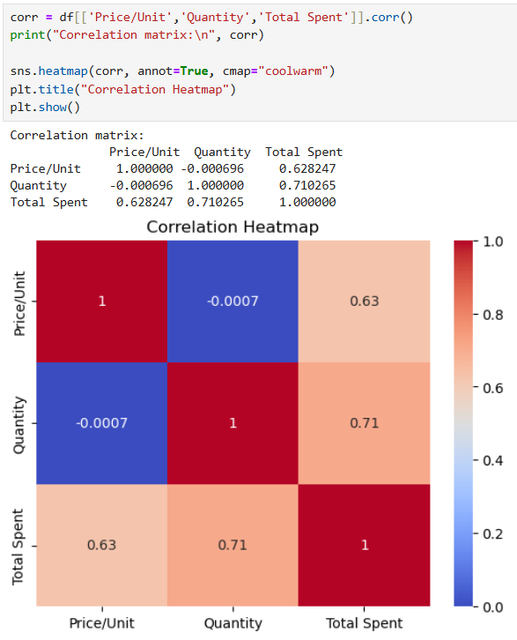
Relationship between variables

Slide 20
Data Visualization
Introduction: Data visualization plays a crucial role in understanding patterns, trends, and anomalies in the dataset. It transforms raw data into visual insights, making it easier to interpret and communicate findings to stakeholders.
Importance:
Helps in quickly spotting patterns and key trends.
Simplifies complex data relationships for decision-making.
Enhances stakeholder communication by presenting insights visually.
Types of Visualizations Used:
Histograms & KDE Plots
Bar Charts
Boxplots
Heatmaps
Pie Charts
75%
25%
50%

Slide 21
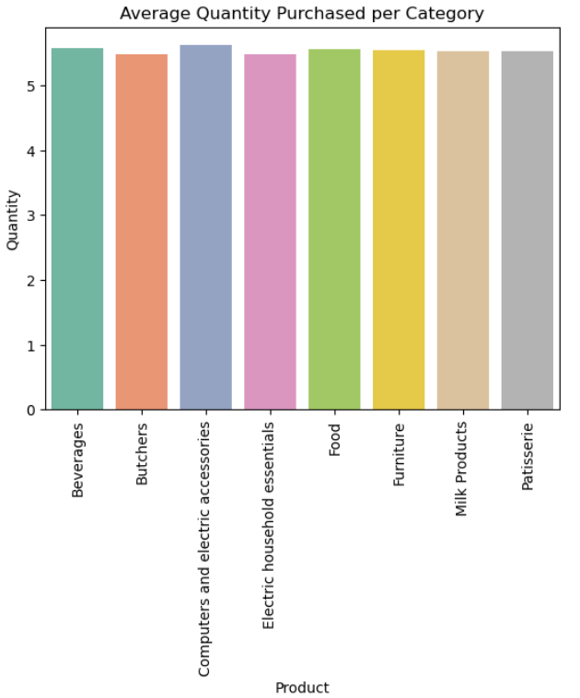
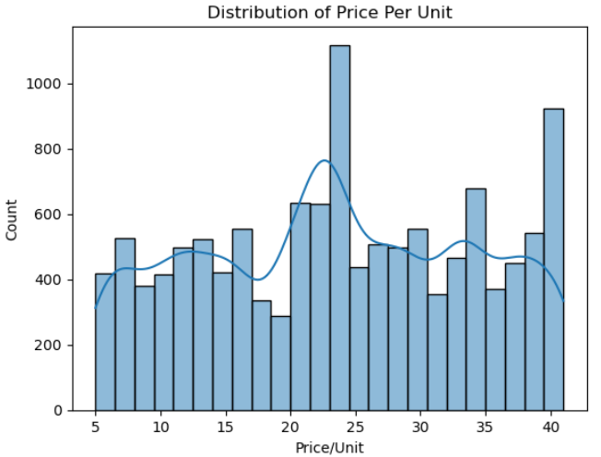
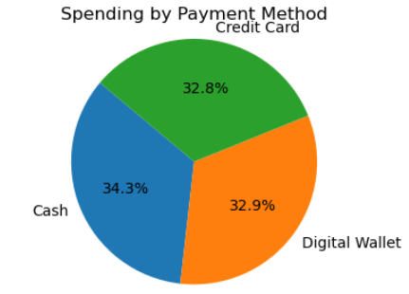
Data Visualization

Slide 22
Univariate Analysis
Objective: To explore and understand the distribution, central tendency, and spread of individual variables in the dataset.
Key Insights:
Total Spent: Right-skewed distribution with few high-value transactions.
Quantity: Most transactions involve low to moderate quantities (majority < 10).
Price/Unit: Majority of products fall in a mid-price range; extreme high prices are rare.
Payment Method: Digital Wallet and Credit Card are the most preferred modes.
Purchase Mode: Online transactions slightly dominate over In-store purchases.
Visualizations Used:
Histograms & KDE Plots
Boxplots
Pie chart

Slide 23
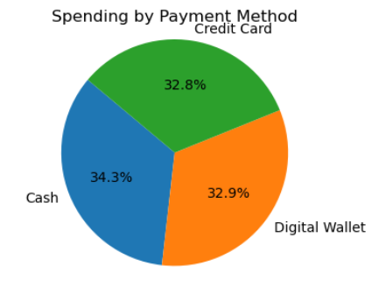
Univariate Data Visualization

Slide 24
Bi-variate Analysis
Objective: Bivariate analysis helps reveal pairwise relationships, supporting data-driven decision-making (e.g., marketing strategy based on payment modes).
Key Insights:
Payment Method has a slight influence on transaction spending, though not statistically significant.
Quantity has a strong positive effect on total spending.
Online vs. Offline spending does not differ significantly, meaning both channels contribute similarly to revenue.
Visualizations Used:
Barplots
Boxplots
Heatmap

Slide 25
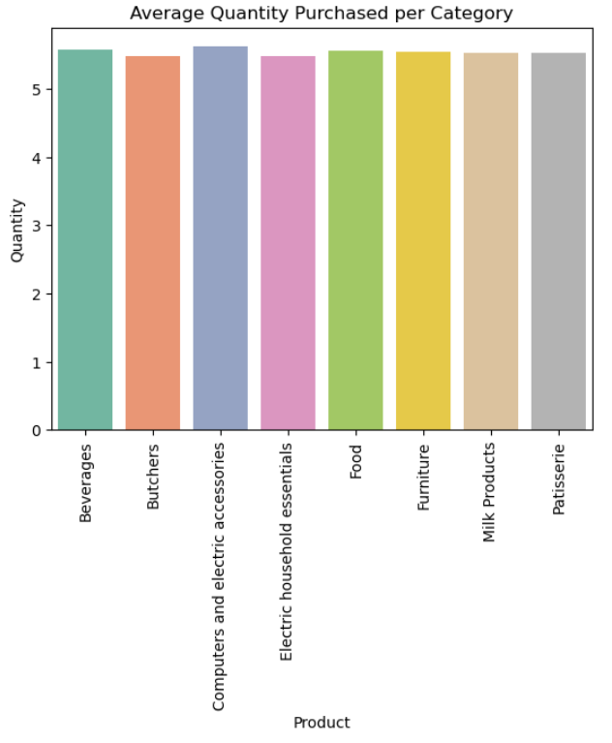
Bi-Variate Data Visualization

Slide 26
Multi-variate Analysis
Objective: To analyze the interaction of three or more variables simultaneously and uncover deeper patterns in the data.
Key Insights:
Seasonality product-specific — some products peak during certain months, useful for inventory planning.
Payment Method & Purchase Mode together influence spending behavior for some products.
High-value transactions are concentrated in a few products and payment methods, indicating target opportunities for marketing campaigns.
Visualizations Used:
Stacked Bar Plots
Pivot Tables + Heatmaps
Grouped Bar Charts

Slide 27
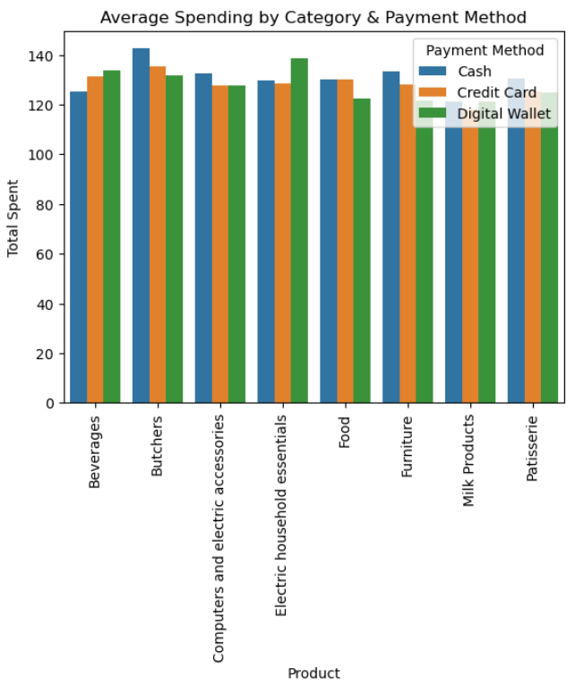
Multi-Variate Data Visualization

Slide 28
Conclusion & Recommendation
Key Findings:
Total Spent is highly influenced by Price/Unit and Quantity (strong positive Correlation).
Purchase Mode (Online vs. In-store) did not significantly affect total spending (t-test result: Fail to Reject H₀).
Product Contribution: A few products dominate total revenue — critical for inventory and promotional strategy.
Recommendations:
Target High-Value Months: Focus marketing campaigns during peak transaction months to maximize revenue.
Product Optimization: Prioritize stocking and promotions for top-selling product categories.
Customer Segmentation: Consider creating loyalty programs or discounts for customers with consistently high spending.
Future Work:
Implement predictive modeling to forecast future sales trends based on seasonality and product demand.
Perform customer segmentation (RFM analysis) to identify high-value customers and personalize marketing strategies.

Slide 29
Thank you

